Slide 1

North western university
Restaurant Management System (Rms)
COURSE CODE: CSE-3204
COURSE TITLE: Software Development Sessional III
SDP III CSE-3204

Slide 2



Team Name
NWU_RMS
Information Of Team Members
Name: Armin Jahan Neha
ID: 20201137010
Department of CSE
North Western University
Name: Najnine Afroze Estina
ID: 20201144010
Department of CSE
North Western University
Name: Rifa Tamanna
ID: 20201145010
Department of CSE
North Western University
SDP III CSE-3204

Slide 3
Overview:
Introduction
Objectives of Project
Benefits of Project
Why need this system?
Project Analysis
Project Review
Admin Panel
Employee Mode
Customer Mode
Site Tree
E-R Diagram
Dependencies
Conclusion
SDP III CSE-3204

Slide 4
Introduction
About our Project:
Admin Panel : In our Project Admin can control Employee Management & Show the Order-list ,Menu-list & Feedback both for Employers & Customers.
Employee mode : Employee can control Billing system & Menu Item & can give Feedback .
Customer Mode : Customer can see the menu item & give the Feedback.
SDP III CSE-3204

Slide 5
Objectives of our Project
Save time for both customer’s and restaurant management team .
Help to run business with much more efficiently than past.
Customer’s can see the food-list easily &
Also can understand easily what kind of food items are available in this restaurant.
Eliminate the huge storage of Physical paper data by storing data into Database.
SDP III CSE-3204

Slide 6
Benefits of Project
The benefits of our project are:
Determine Profits & Costs.
Reduce the order processing time.
Employee Satisfaction.
Automate redundant work.
Keep track of customer’s data.
Safer and more secure data management.
SDP III CSE-3204

Slide 7
Why we need this system?
Misunderstanding when the customer is unaware of the food price or food category.
Doubt on Employee’s (from Admin’s point of view)
To provoke this types of problems we need this
system.
SDP III CSE-3204

Slide 8
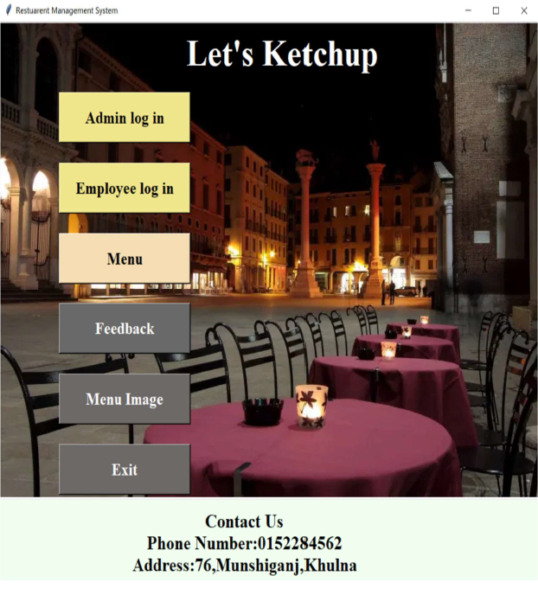
Project Analysis:
Home page of Restaurant management System.
SDP III CSE-3204

Slide 9
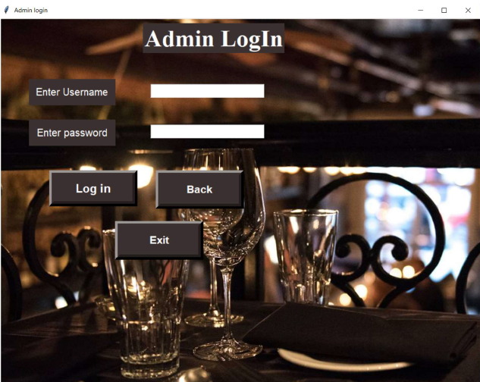
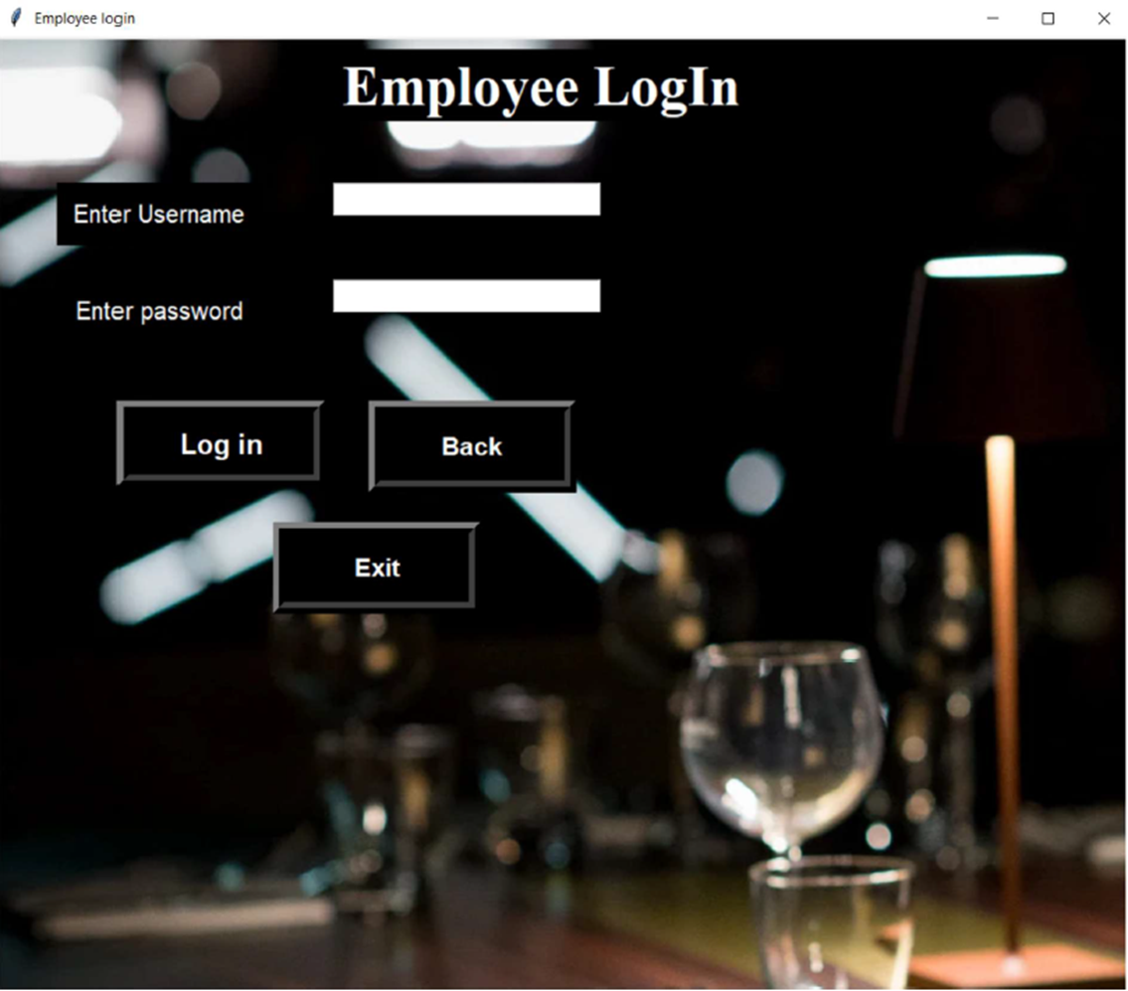
Login Pages:
Two characters login pages
SDP III CSE-3204

Slide 10
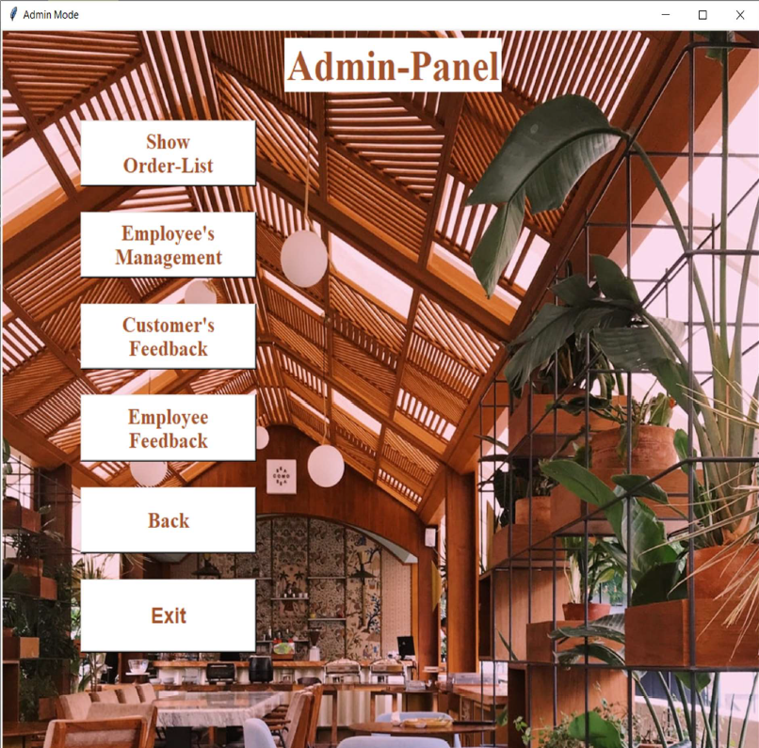
Admin-Panel:
Login successfully, The Admin can view the Admin Panel of the Restaurant management system.
An Admin can Add, view, Update, Delete, check the information to the system
SDP III CSE-3204

Slide 11
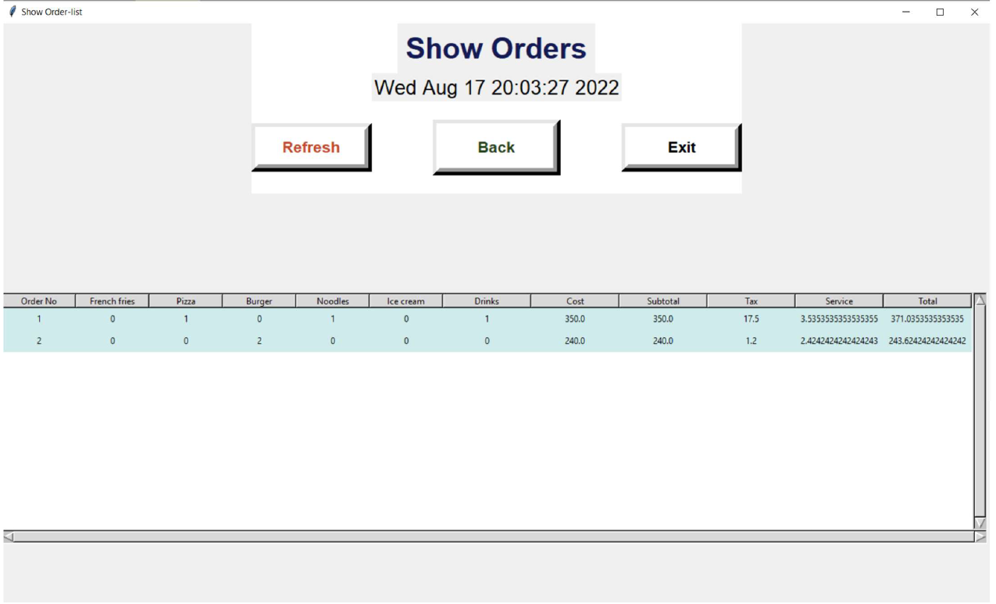
Clicking Show Order Admin can see the order list.
SDP III CSE-3204

Slide 12
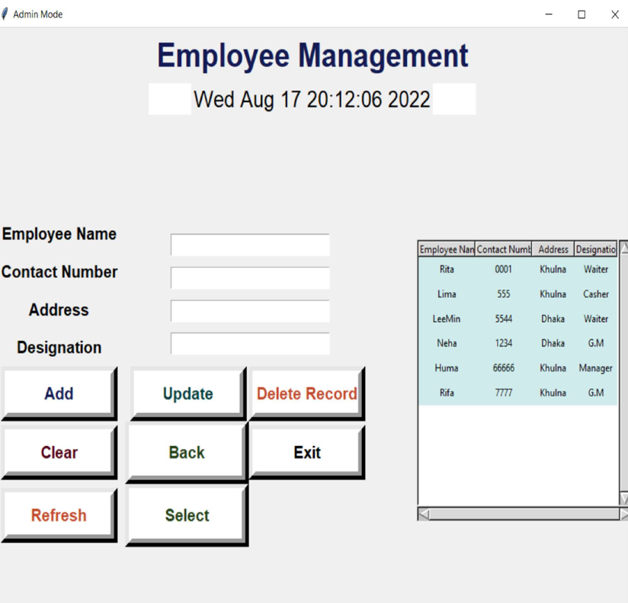
Clicking Employee Management the Admin will be able to add, update, delete employee information.
SDP III CSE-3204

Slide 13
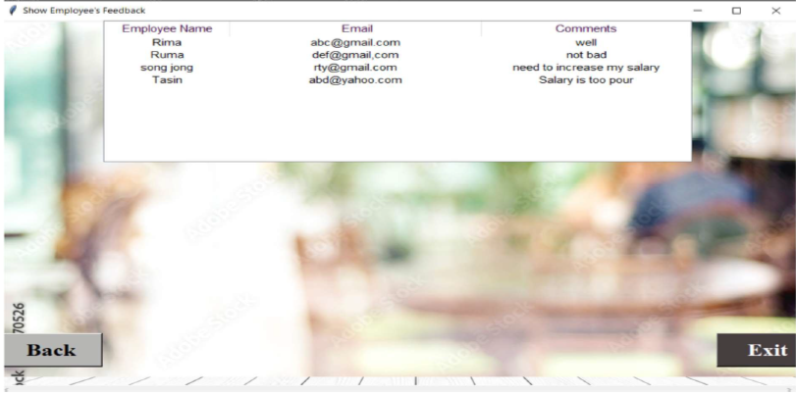
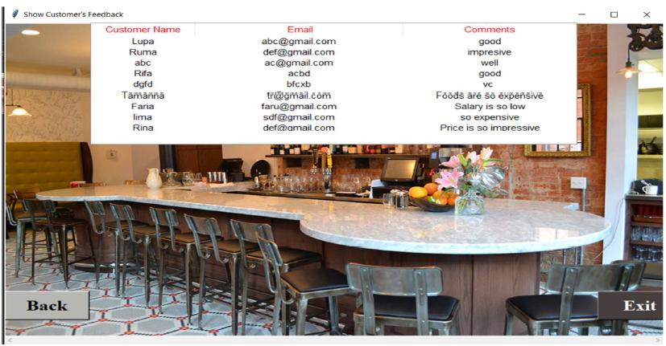
Clicking Show Feedback, the Admin will be able to View the feedback which is claim by the Employee.
Clicking Show Feedback, the Admin will be able to View the feedback which is claim by the Customer.
SDP III CSE-3204

Slide 14
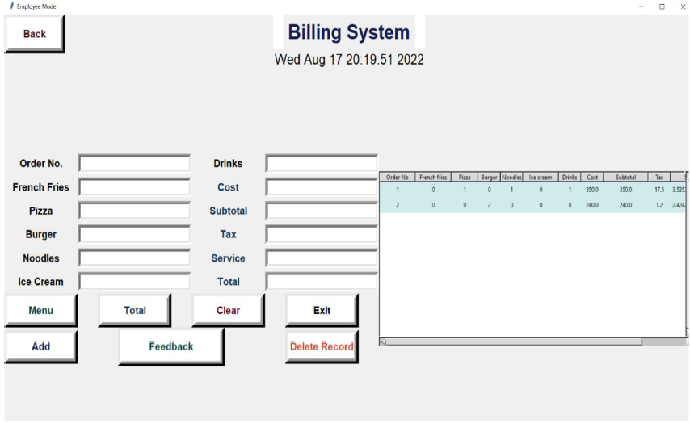
Employee Mode:
Login successfully, The Employee can view the Billing System of the Restaurant management system.
A Employee can add & view the order to the system.
SDP III CSE-3204

Slide 15
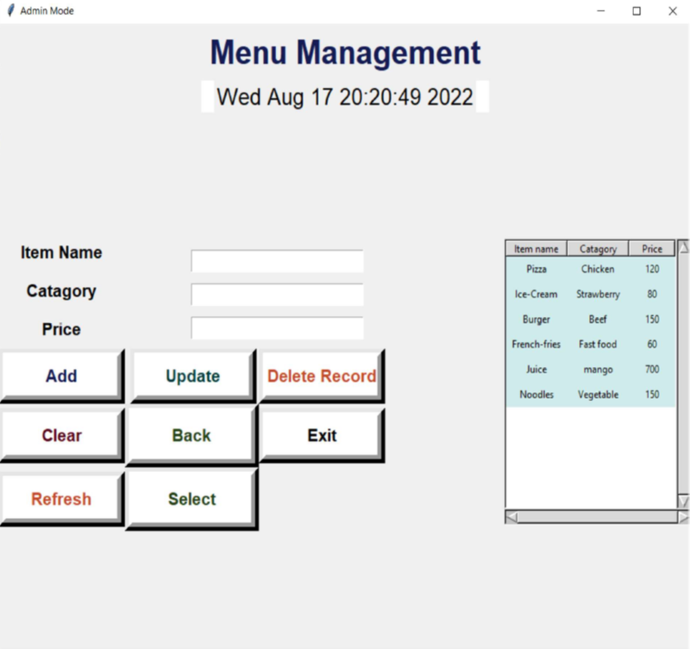
Clicking Menu the Employee will be able to add, update, delete menu-list.
SDP III CSE-3204

Slide 16
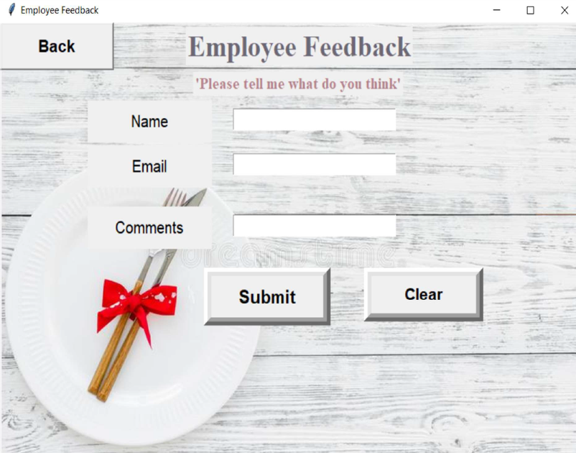
Clicking Feedback the Employee will be able to give a feedback to Admin.
SDP III CSE-3204

Slide 17
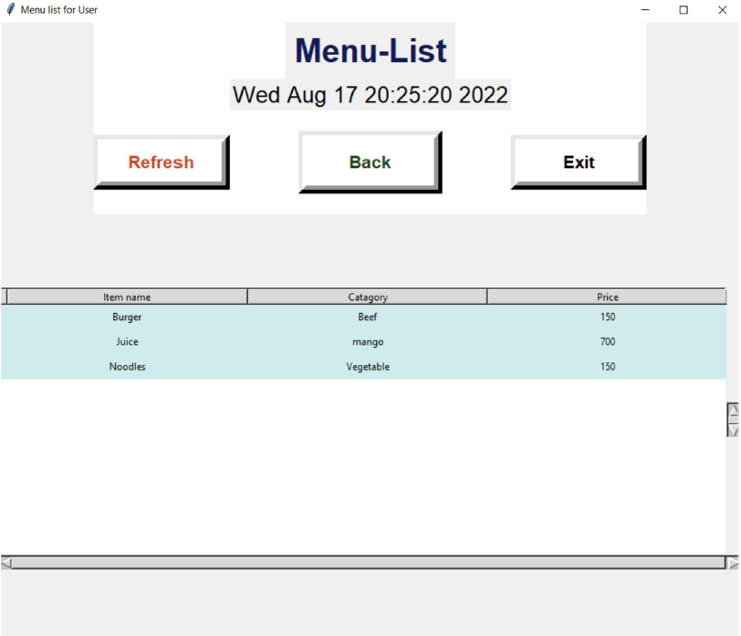
Customer Mode:
Clicking Menu-List Customer can see the item of Food.
SDP III CSE-3204

Slide 18
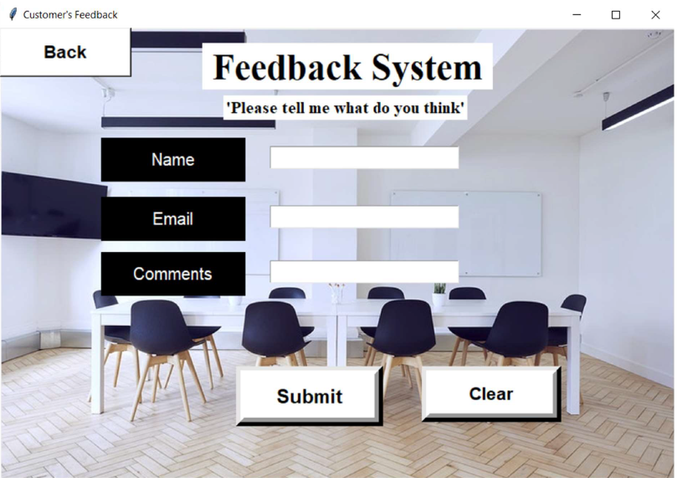
Clicking Feedback the Customer will be able to give a feedback to Admin.
SDP III CSE-3204

Slide 19
Project Analysis
According to our project goal we have to do following things:
User interface (Food items, Price & category)
Admin and Employee login option.
Bill receiving system.
Feedback system for both Employees & Customers.
SDP III CSE-3204

Slide 20
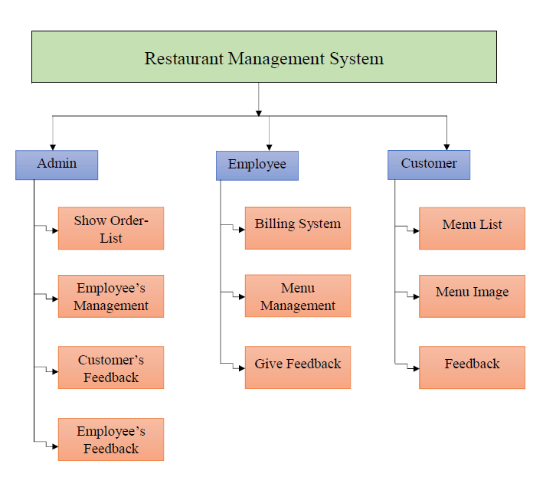
There are three characters.
Admin,
Employee,
Customer.
Site Tree
SDP III CSE-3204

Slide 21
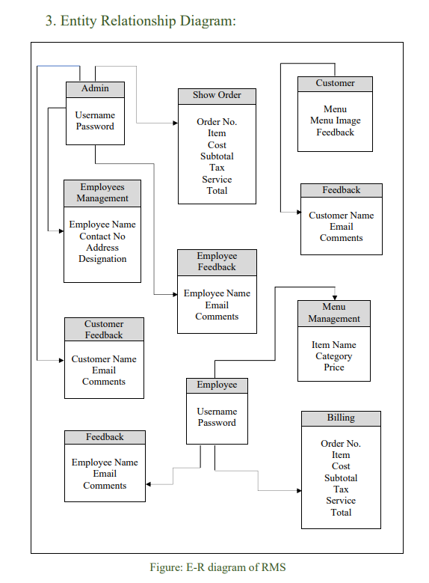
SDP III CSE-3204

Slide 22
Dependencies:
RMS is built on Python 3.10.6-amd64 & Pycharm-community-2022.1.3.
Xampp: The Restaurant Management system (rms)’s database is Store in local server. So xampp software is needed to run this project properly.
Tkinter: We have used Python Tkinter Module for the User Interface. So, you must have to import the Tkinter Module for successfully executing this project.
SDP III CSE-3204

Slide 23
Conclusion
A restaurant management system is essential for users to run their restaurant efficiently and smoothly. Users may not be at the restaurant all the times but users must have access to the data all the times and a robust restaurant management system helps users to do that.
SDP III CSE-3204

Slide 24
Thank You
SDP III CSE-3204

